Slide 1
Feedback and Control System
Lecture 2

Slide 2
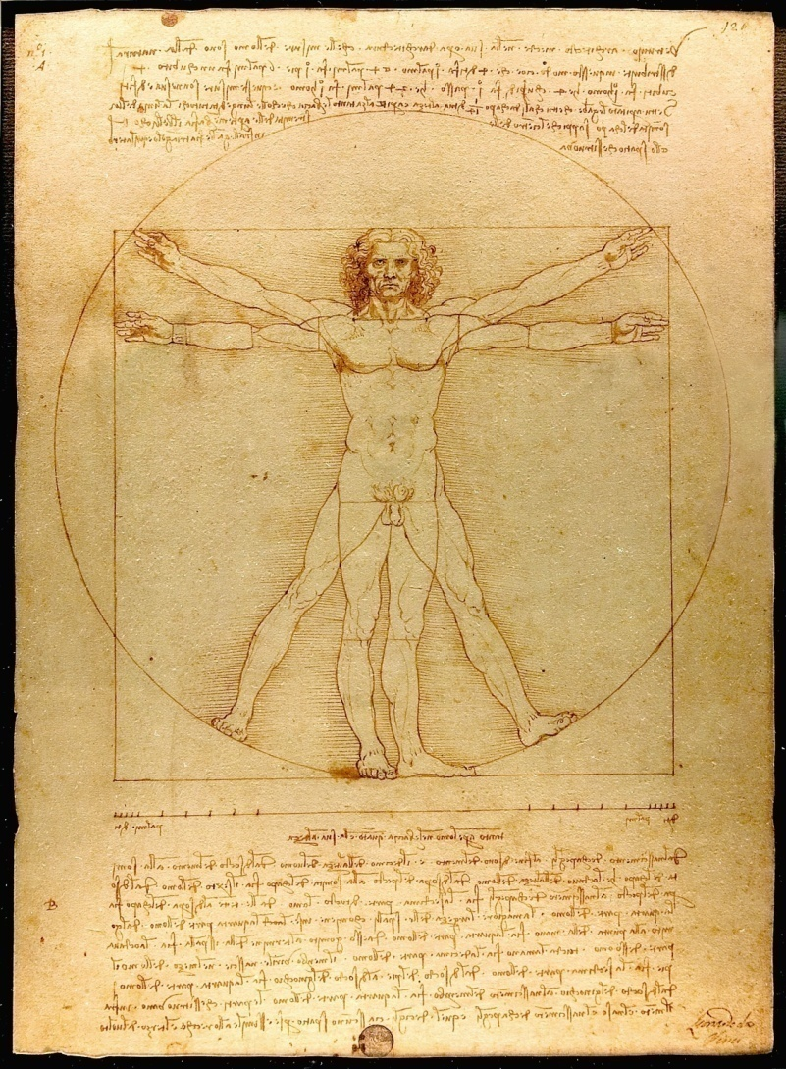
Human System
The Vetruvian Man

Slide 3
Human System
Pancreas
Regulates blood glucose level
Adrenaline
Automatically generated to increase the heart rate and oxygen in times of flight
Eye
Follow moving object
Hand
Pick up an object and place it at a predetermined location
Temperature
Regulated temperature of 36°C to 37°C

Slide 4
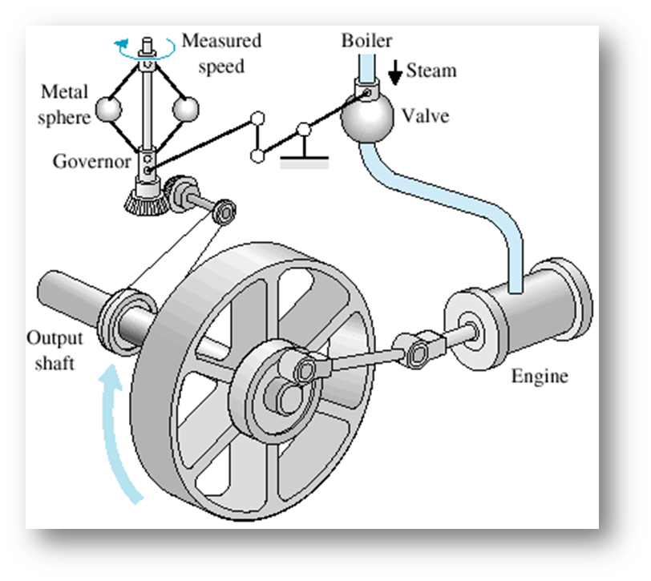
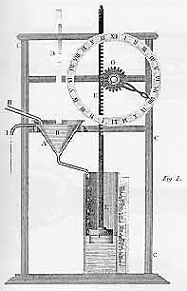
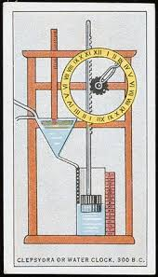
History of Control System

Slide 5
Historical Developments in Control System
Ancient Greece (1 to 300 BC)
Water float regulation, water clock, automatic oil lamp
Cornellis Drebbel (17th century)
Temperature control
James Watt (18th century)
Flyball governor
Late 19th to mid 20th century
Modern control theory

Slide 6
History
18th Century James Watt’s centrifugal governor for the speed control of a steam engine.
1920s Minorsky worked on automatic controllers for steering ships.
1930s Nyquist developed a method for analyzing the stability of controlled systems
1940s Frequency response methods made it possible to design linear closed-loop control systems
1950s Root-locus method due to Evans was fully developed
1960s State space methods, optimal control, adaptive control and
1980s Learning controls are begun to investigated and developed.
Present and on-going research fields. Recent application of modern control theory includes such non-engineering systems such as biological, biomedical, economic and socio-economic systems

Slide 7
1769 | James Watts's steam engine and governor deployed. The Watt steam engine is often used to mark the beginning of the Industrial Revolution in Great Britain. During the Industrial Revolution, great strides were made in the development of mechanization, a technology preceding automation
1800 | Eli Whitney's concept of interchangeable parts manufacturing demonstrated in the production of muskets. Whitney's development is often considered to be the beginning of mas production
1868 | J.C. Maxwell formulates a mathematical model for a governor control of a steam engine
1913 | Henry Ford's mechanized assembly machine introduced for automobile production
1927 | H.S Black conceives of the negative feedback amplifier and H.W. Bode analyzes feedback amplifiers
1932 | H. Nyquist develops a method for analyzing the stability systems
1941 | Creation of first antiaircraft gun with active control
1952 | Numerical control (NC) developed at Massachusetts Institute of Technology for control of machine-tool axes
1954 | George Devol develops "programmed article transfer" considered to be the first industrial robot design
1957 | Soutnik launches the space age leading, in time, to miniaturization of computers and advances in automatic control theory
1960 | First Unimate robot introduced, based on Devol's design. Unimate installed in 1961 for tending die-casting machine
1970 | State-variable models and optimal control developed
1980 | Robust control system design widely studied
1983 | Introduction of the personal computer (and control design software soon there after) brought the tools of design to the engineer's desktop
1990 | Export oriented manufacturing companies emphasize automation
1994 | Feedback control widely used in automobiles. Reliable, robust systems demanded in manufacturing
1997 | First ever autonomous rover vehicle, known as Sojourner, explores the Martian surface
1998-2003 | Advances in micro- and nanotechnology. First intelligent micromachines are developed and fuctioning nanomachines are created

Slide 8
Design of Feedback Control System
Step 1. Transform requirements into a physical system
Step 2. Draw a functional block diagram
Step 3. Create a schematic
Step 4. Develop a mathematical model
Step 5. Reduce the block diagram
Step 6. Analyze and design

Slide 9
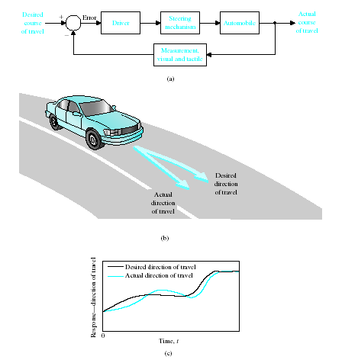
Examples of Modern Control Systems
(a) Automobile steering control system.
(b) The driver uses the difference between the actual and the desired direction of travel
to generate a controlled adjustment of the steering wheel.
(c) Typical direction-of-travel response.

Slide 10
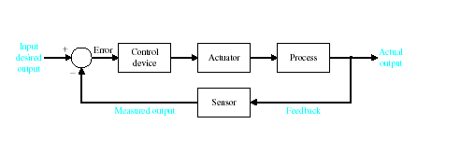

Examples of Modern Control Systems

Slide 11
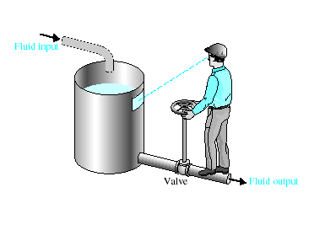

Examples of Modern Control Systems

Slide 12
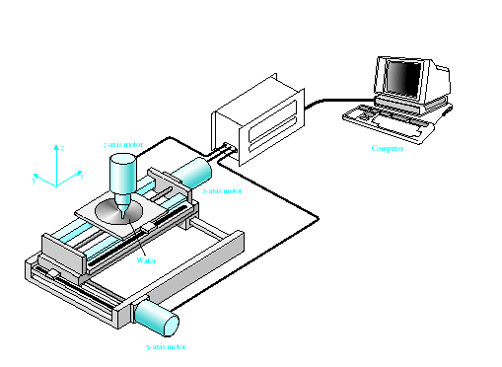

Examples of Modern Control Systems

Slide 13
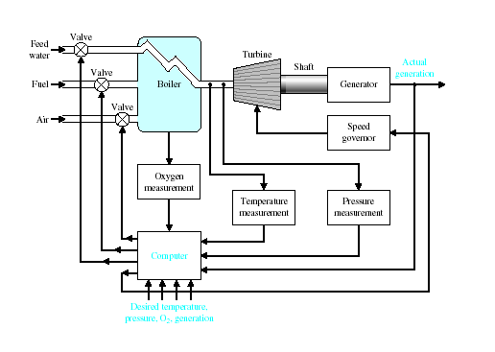

Examples of Modern Control Systems

Slide 14
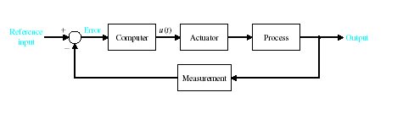

Examples of Modern Control Systems

Slide 15
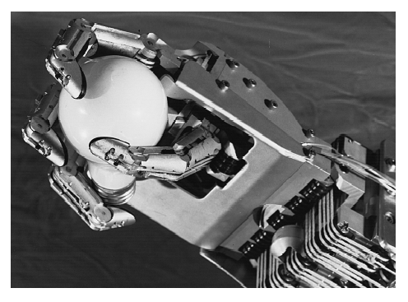
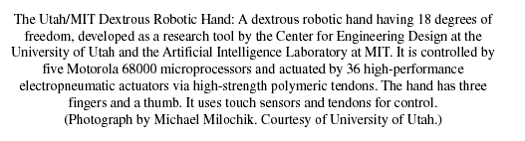
Examples of Modern Control Systems

Slide 16
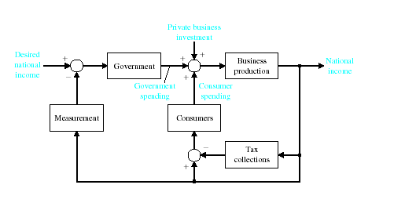

Examples of Modern Control Systems

Slide 17
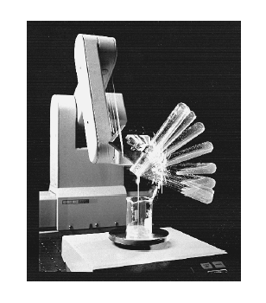

Examples of Modern Control Systems

Slide 18
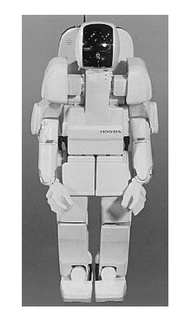

The Future of Control Systems

Slide 19
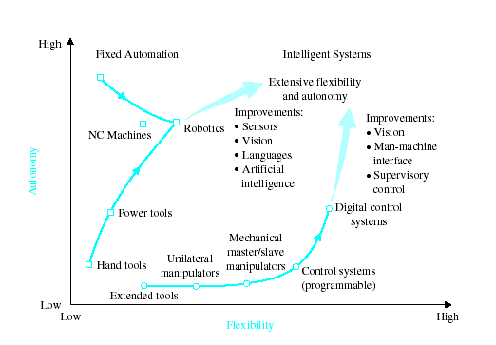

The Future of Control Systems

Slide 20
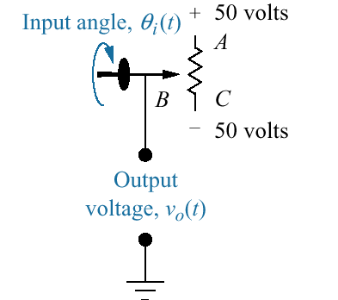
Design Example

Slide 21
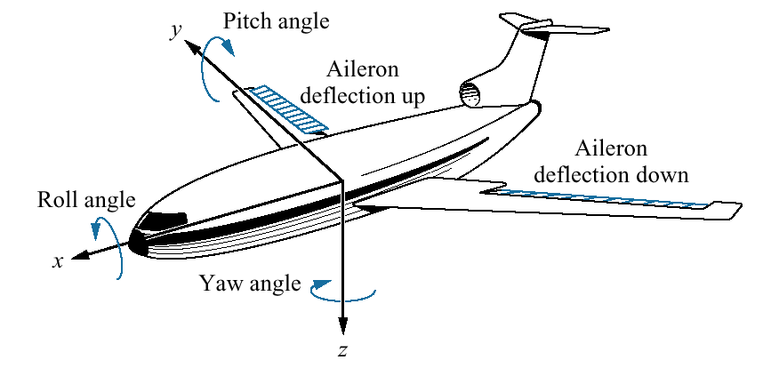
Design Example

Slide 22
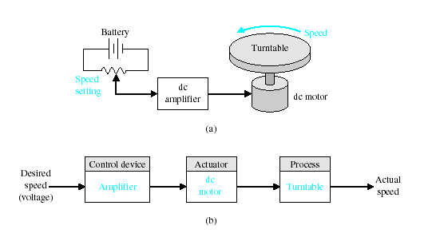

Design Example

Slide 23
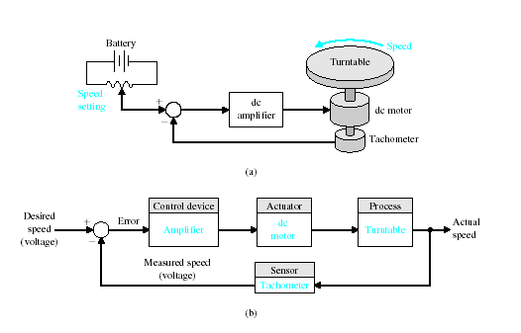

Design Example

Slide 24
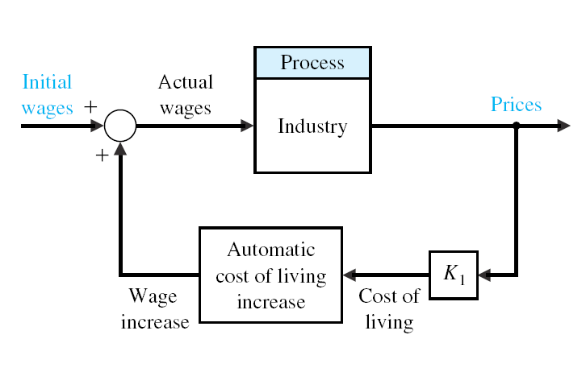

Slide 25
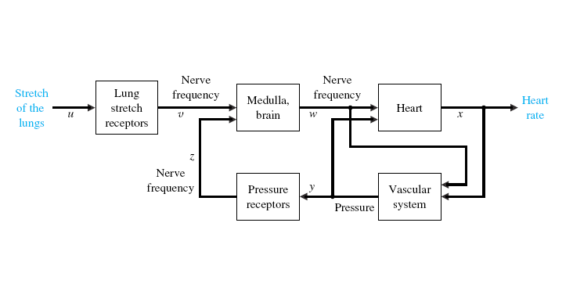

Slide 26
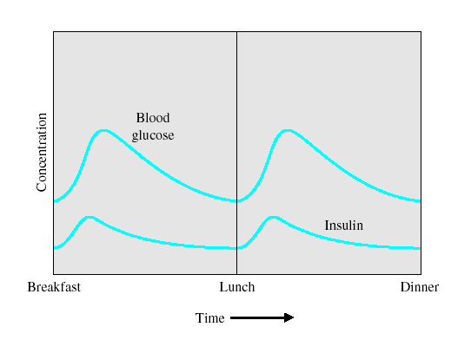

Design Example

Slide 27
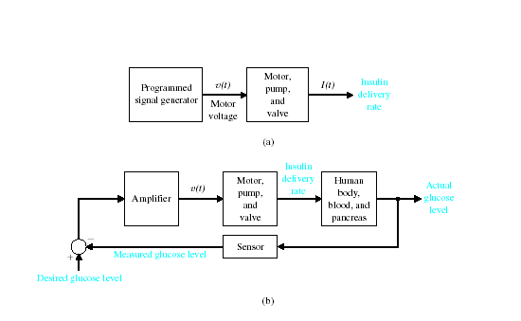

Design Example

Slide 28
FOUR PRIMARY REASONS FOR CONTROL SYSTEM
Power amplifier
For example, a radar antenna, positioned by the low-power rotation of a knob at the input, requires a large amount of power for its output rotation.
Remote control
For example, a remote-controlled robot arm can be used to pick-up material in a radioactive environment.
Convenience of input form
For example, in a temperature control system, the input is a position on a thermostat and the output is a heat. Thus, a convenient position input yield a desired thermal output.
Compensate for disturbances
Typically, we control variables as temperature in thermal systems, position and velocity in mechanical systems, and voltage, current, or frequency in electrical system.
Notes:
Power Amplification (Gain)
Positioning of a large radar antenna by low-power rotation of a knob
Remote Control
Robotic arm used to pick up radioactive materials
Convenience of Input Form
Changing room temperature by thermostat position
Compensation for Disturbances
Controlling antenna position in the presence of large wind disturbance torque

Slide 29
THE CONTROL SYSTEMS ENGINEERING PROBLEM
Control systems engineering consists of analysis and design of control systems configurations.
Analysis
It is the investigation of the properties of an existing system.
Design
It is the choice and arrangement of system components to perform a specific task.
Design by Analysis
It is accomplished by modifying the characteristics of an existing or standard system configuration.
Design by Synthesis
It is by defining the form of the system directly from its specifications.

